Slide 1
BCT 2305 DATA COMMUNICATION
Lecture 1: Introduction to Data Communication

Slide 2

Introduction to communications
Historical review
Early history of communication
1799 Alessandro Volta invented electric battery,
1837 Samuel Morse demonstrated telegraph and 1844 first telegraph line (Washington-Baltimore) became operational
Early history of wireless communication
1831 Faraday demonstrates electromagnetic induction
J. Maxwell (1831-79): theory of electromagnetic Fields, wave equations (1864)
H. Hertz (1857-94): demonstrates with an
experiment the wave character of electrical
transmission through space(1888, in Karlsruhe,
Germany, at the location of today’s
University of Karlsruhe)

Slide 3
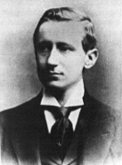
Introduction to communications
Historical review
Early history of wireless communication I
1895 Guglielmo Marconi
first demonstration of wireless telegraphy (digital!)
long wave transmission, high transmission power necessary (> 200kw)
1907 Commercial transatlantic connections
huge base stations (30 100m high antennas)
1915 Wireless voice transmission New York - San Francisco
1920 Discovery of short waves by Marconi
reflection at the ionosphere
smaller sender and receiver, possible due to the invention of the vacuum tube (1906, Lee DeForest and Robert von Lieben)
1926 Train-phone on the line Hamburg - Berlin
wires parallel to the railroad track

Slide 4
Introduction to communications
Historical review
Early history of wireless communication II
1928 many TV broadcast trials (across Atlantic, color TV, TV news)
1933 Frequency modulation (E. H. Armstrong)
1958 A-Netz in Germany
analog, 160MHz, connection setup only from the mobile station, no handover, 80% coverage, 1971 11000 customers
1972 B-Netz in Germany
analog, 160MHz, connection setup from the fixed network too (but location of the mobile station has to be known)
available also in A, NL and LUX, 1979 13000 customer in D
1979 NMT at 450MHz (Scandinavian countries)
1982 Start of GSM-specification
goal: pan-European digital mobile phone system with roaming
1983 Start of the American AMPS (Advanced Mobile Phone System, analog)
1984 CT-1 standard (Europe) for cordless telephones

Slide 5
Introduction to communications
Historical review
Early history of wireless communication III
1986 C-Netz in Germany
analog voice transmission, 450MHz, hand-over possible, digital signaling, automatic location of mobile device
Was in use until 2000, services: FAX, modem, X.25, e-mail, 98% coverage
1991 Specification of DECT
Digital European Cordless Telephone (today: Digital Enhanced Cordless Telecommunications)
1880-1900MHz, ~100-500m range, 120 duplex channels, 1.2Mbit/s data transmission, voice encryption, authentication, up to several 10000 user/km², used in more than 50 countries
1992 Start of GSM
in D as D1 and D2, fully digital, 900MHz, 124 channels
automatic location, hand-over, cellular
roaming in Europe - now worldwide in more than 170 countries
services: data with 9.6kbit/s, FAX, voice, ...

Slide 6
Introduction to communications
Historical review
Early history of wireless communication IV
1994 E-Netz in Germany
GSM with 1800MHz, smaller cells
As Eplus in D (1997 98% coverage of the population)
1996 HiperLAN (High Performance Radio Local Area Network)
ETSI, standardization of type 1: 5.15 - 5.30GHz, 23.5Mbit/s
recommendations for type 2 and 3 (both 5GHz) and 4 (17GHz) as wireless ATM-networks (up to 155Mbit/s)
1997 Wireless LAN - IEEE802.11
IEEE standard, 2.4 - 2.5GHz and infrared, 2Mbit/s
already many (proprietary) products available in the beginning
1998 Specification of GSM successors
for UMTS (Universal Mobile Telecommunication System) as European proposals for IMT-2000
Iridium
66 satellites (+6 spare), 1.6GHz to the mobile phone

Slide 7
Introduction to communications
Historical review
Early history of wireless communication V
1999 Standardization of additional wireless LANs
IEEE standard 802.11b, 2.4-2.5GHz, 11Mbit/s
Bluetooth for piconets, 2.4Ghz, <1Mbit/s
Decision about IMT-2000
Several “members” of a “family”: UMTS, cdma2000, DECT, …
Start of WAP (Wireless Application Protocol) and i-mode
First step towards a unified Internet/mobile communication system
Access to many services via the mobile phone
2000 GSM with higher data rates
HSCSD offers up to 57,6kbit/s
First GPRS trials with up to 50 kbit/s (packet oriented!)
UMTS auctions/beauty contests
Hype followed by disillusionment (approx. 50 B$ payed in Germany for 6 UMTS licenses!)
2001 Start of 3G systems
Cdma2000 in Korea, UMTS in Europe, Foma (almost UMTS) in Japan

Slide 8
Introduction to communications
Elements of a communication system
Basic concepts
Sources (information inputs)
voice (audio), text, image/video and data
Signals
Analogue signals, Digital signals
Noises
Thermal noise, man-made noise, atmospheric noise, etc
Sinks (information output devices)
Computer screens, speakers, TV screens, etc

Slide 9
Introduction to communications
Elements of a communication system (cont)
Basic components
Transmitter
Convert Source (information) to signals
Send converted signals to the channel (by antenna if applicable)
Channel
Wireless: atmosphere (free space)
Wired: coaxial cables, twisted wires, optical fibre
Receiver
Reconvert received signals to original information
Output the original information
Signal Processing
Carrier Circuits
Transmission Medium
Carrier Circuits
Signal Processing
m(t)
s(t)
r(t)
TRANSMITTER
CHANNEL
RECEIVER

Slide 10
Introduction to communications
Elements of a communication system (cont)
Frequencies for communication
twisted pair
coax cable
optical transmission
1 Mm
300 Hz
10 km
30 kHz
100 m
3 MHz
1 m
300 MHz
10 mm
30 GHz
100 μm
3 THz
1 μm
300 THz
VLF
LF
MF
HF
VHF
UHF
SHF
EHF
infrared
visible light
UV
VLF = Very Low Frequency UHF = Ultra High Frequency
LF = Low Frequency SHF = Super High Frequency
MF = Medium Frequency EHF = Extra High Frequency
HF = High Frequency UV = Ultraviolet Light
VHF = Very High Frequency
Frequency and wave length:
λ = c/f
wave length λ, speed of light c ≅ 3x10⁸m/s, frequency f

Slide 11
Introduction to communications
Basic digital communications system
Signals processing
Source encoding/decoding
Reduction of redundancy
Encryption /decryption
Security and privacy
Channel encoding/decoding
Anti-interferences
Modulation/demodulations
Channel adaptation and sharing
Basic digital communications system
Shown in the picture next slide

Slide 12
Introduction to communications
Baseband
Passband
audio
video
(analogue)
data
(digital)
A/D
Channel
Code
ASK
FSK
PSK
binary
M’ary
Modulation
anti-alias
filter
•Nyquist
sampling
FEC
ARQ
block
convolution
pulse
shaping
filter
ISI
channel
filter
Source
Source
code
Transmit
Communications
Channel
loss
interference
noise
distortion
Receive
data
(digital)
audio
video
(analogue)
Source
decode
Sink
D/A
Channel
Decode
Regeneration
Demodulation
low pass
filter
quantisation
noise
FEC
ARQ
Block
Convolution
matched filter
decision threshold
timing recovery
envelope
coherent
carrier recovery
channel
filter
Basic Digital Communications System

Slide 13

Note
To be transmitted, data must be transformed to electromagnetic signals.

Slide 14
ANALOG AND DIGITAL SIGNALS
Data can be analog or digital. The term analog data refers to information that is continuous; digital data refers to information that has discrete states. Analog data take on continuous values. Digital data take on discrete values.
Analog and Digital Data Analog and Digital Signals Periodic and Nonperiodic Signals
In electronics, the information must of course be converted into an electrical signal, a voltage or a current, first. E.g , a microphone converts sound into a voltage, which we first amplify and then use as information signal, vm(t). This signal is again a time varying signal, which can be represented as a linear combination of sinusoids. The frequency band of this signal, however, is not suitable for transmission in air, as it is. This frequency band is rather low for transmission and it is called base-band. The information signal occupying this band is referred to as base-band signal. Converting the information-carrying signal to a form suitable for (electromagnetic) transmission is called modulation.

Slide 15
Note
Data can be analog or digital. Analog data are continuous and take continuous values.
Digital data have discrete states and take discrete values.

Slide 16
Note
Signals can be analog or digital. Analog signals can have an infinite number of values in a range; digital signals can have only a limited number of values.

Slide 17
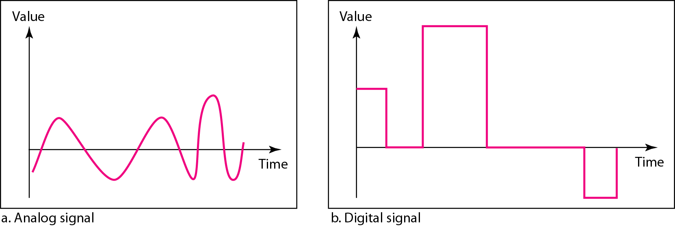
Figure 3.1 Comparison of analog and digital signals

Slide 18
Note
In data communications, we commonly use periodic analog signals and nonperiodic digital signals.

Slide 19
PERIODIC ANALOG SIGNALS
Periodic analog signals can be classified as simple or composite. A simple periodic analog signal, a sine wave, cannot be decomposed into simpler signals. A composite
periodic analog signal is composed of multiple sine waves.
Topics discussed in this section:
Sine Wave Wavelength Time and Frequency Domain Composite Signals
Bandwidth

Slide 20
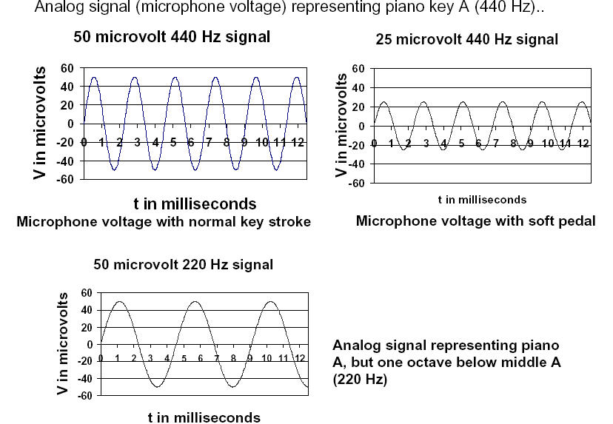

Slide 21
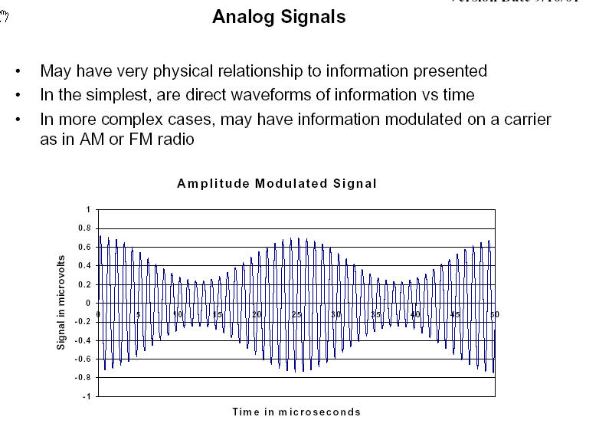

Slide 22
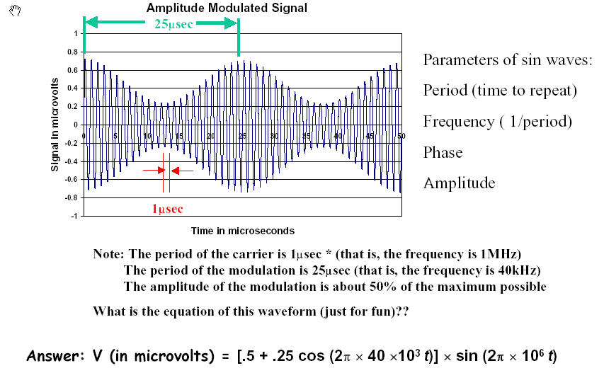

Slide 23
Why Digital
Digital signals can be transmitted, received, amplified, and retransmitted with no degradation.
Binary numbers are a natural method of expressing logic variables.
Complex logic functions are easily expressed as binary function.
With digital representation, we can achieve arbitrary levels of “ dynamic range,” that is, the ratio of the largest possible signal to the smallest than can be distinguished above the background noise.
Digital information is easily and inexpensively stored

Slide 24
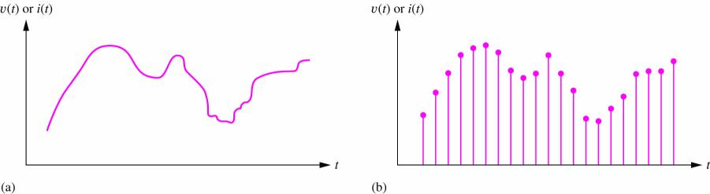
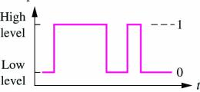
Signal Types
Analog signals take on continuous values - typically current or voltage.
Digital signals appear at discrete levels. Usually we use binary signals which utilize only two levels.
One level is referred to as logical 1 and logical 0 is assigned to the other level.

Slide 25
Analog and Digital Signals
Analog signals are continuous in time and voltage or current. (Charge can also be used as a signal conveyor.)
After digitization, the continuous analog signal becomes a set of discrete values, typically separated by fixed time intervals.

Slide 26
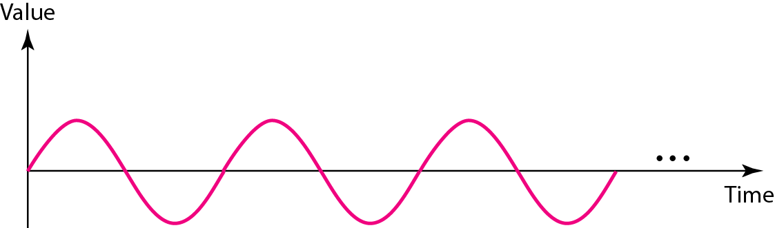
Figure 3.2 A sine wave

Slide 27
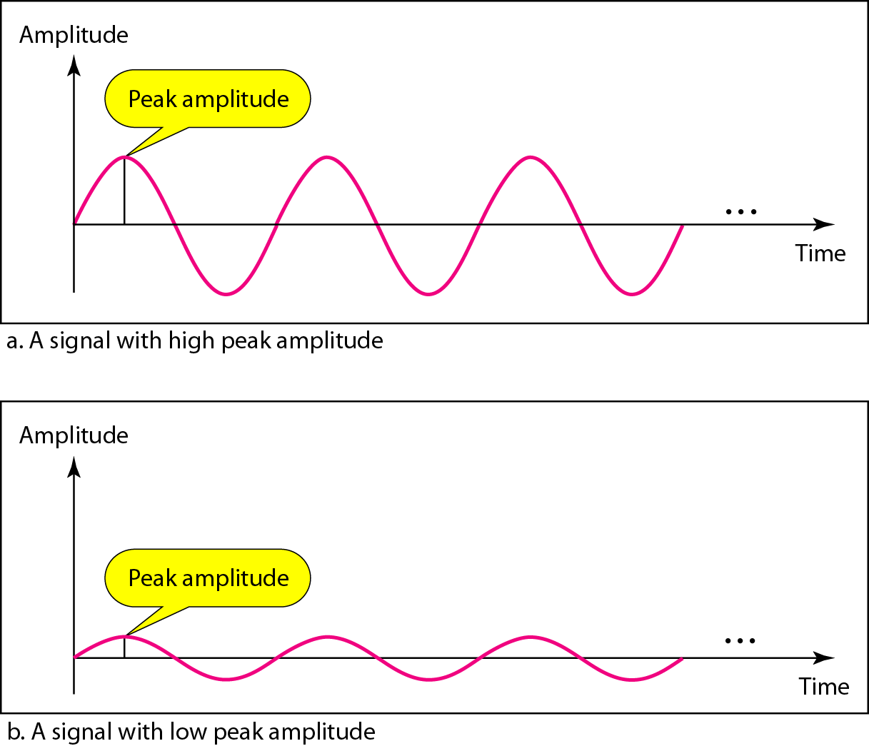
Figure 3.3 Two signals with the same phase and frequency, but different amplitudes

Slide 28

Note
Frequency and period are the inverse of each other.

Slide 29
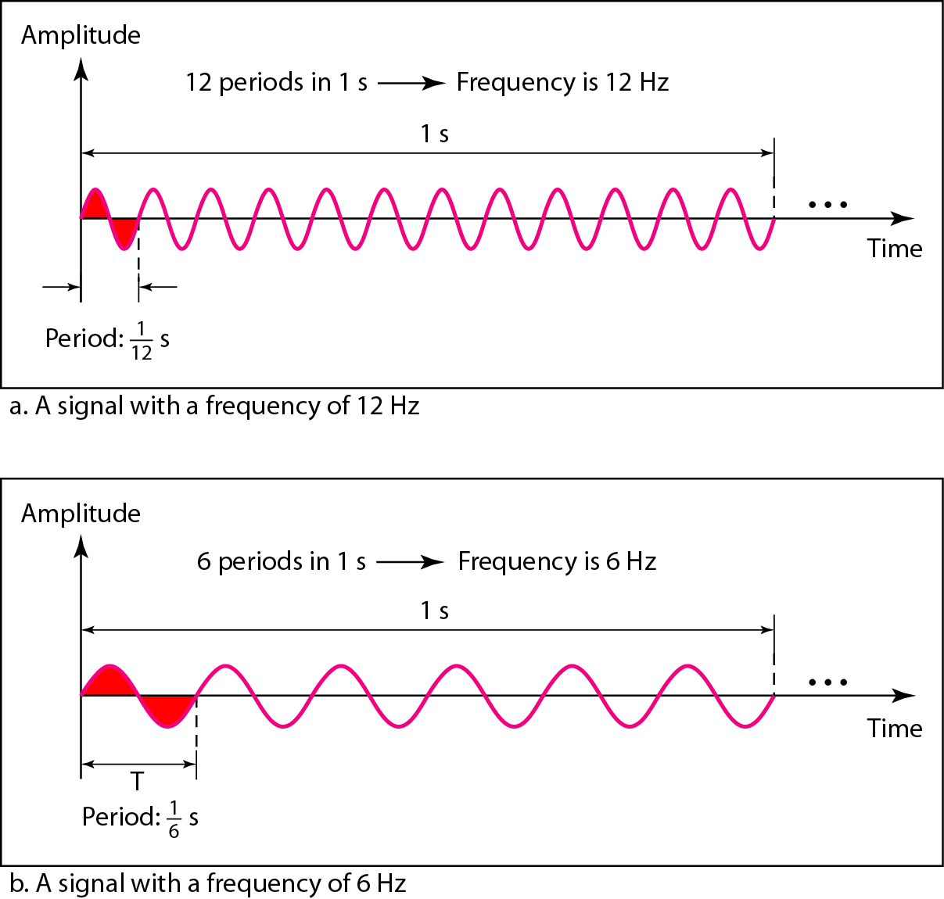
Figure 3.4 Two signals with the same amplitude and phase, but different frequencies

Slide 30
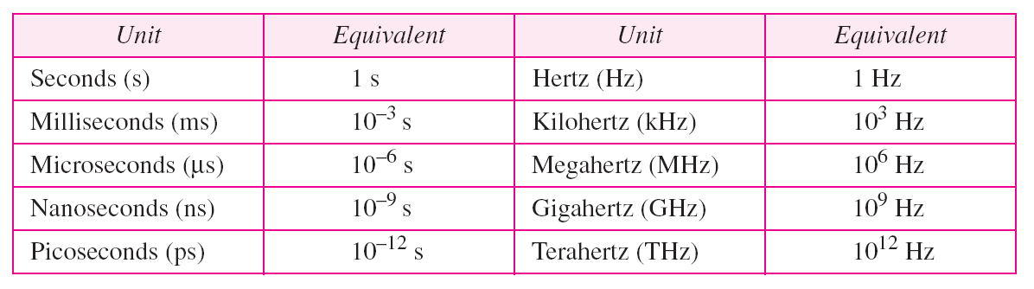
Table 3.1 Units of period and frequency

Slide 31
Example 3.3
The power we use at home has a frequency of 60 Hz. The period of this sine wave can be determined as follows:

Slide 32
Example 3.4
Express a period of 100 ms in microseconds.
Solution
From Table 3.1 we find the equivalents of 1 ms (1 ms is 10⁻³ s) and 1 s (1 s is 10⁶ μs). We make the following substitutions:.

Slide 33
Example 3.5
The period of a signal is 100 ms. What is its frequency in kilohertz?
Solution
First we change 100 ms to seconds, and then we calculate the frequency from the period (1 Hz = 10⁻³ kHz).

Slide 34
Note
Frequency is the rate of change with respect to time. Change in a short span of time
means high frequency. Change over a long span of time means low frequency.

Slide 35
Note
If a signal does not change at all, its frequency is zero.
If a signal changes instantaneously, its frequency is infinite.

Slide 36
Note
Phase describes the position of the waveform relative to time 0.

Slide 37
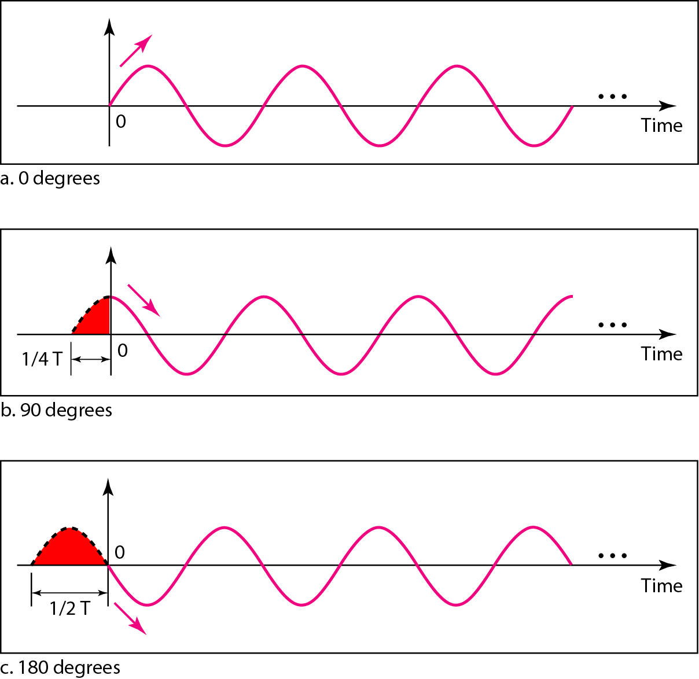
Figure 3.5 Three sine waves with the same amplitude and frequency, but different phases

Slide 38
Example 3.6
A sine wave is offset 1/6 cycle with respect to time 0. What is its phase in degrees and radians?
Solution
We know that 1 complete cycle is 360°. Therefore, 1/6 cycle is

Slide 39
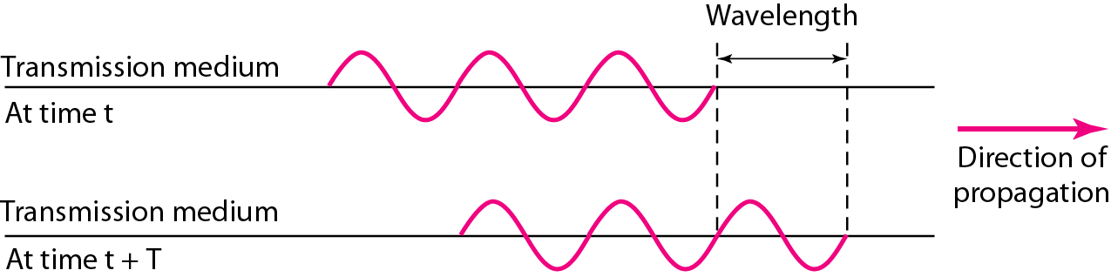
Figure 3.6 Wavelength and period

Slide 40
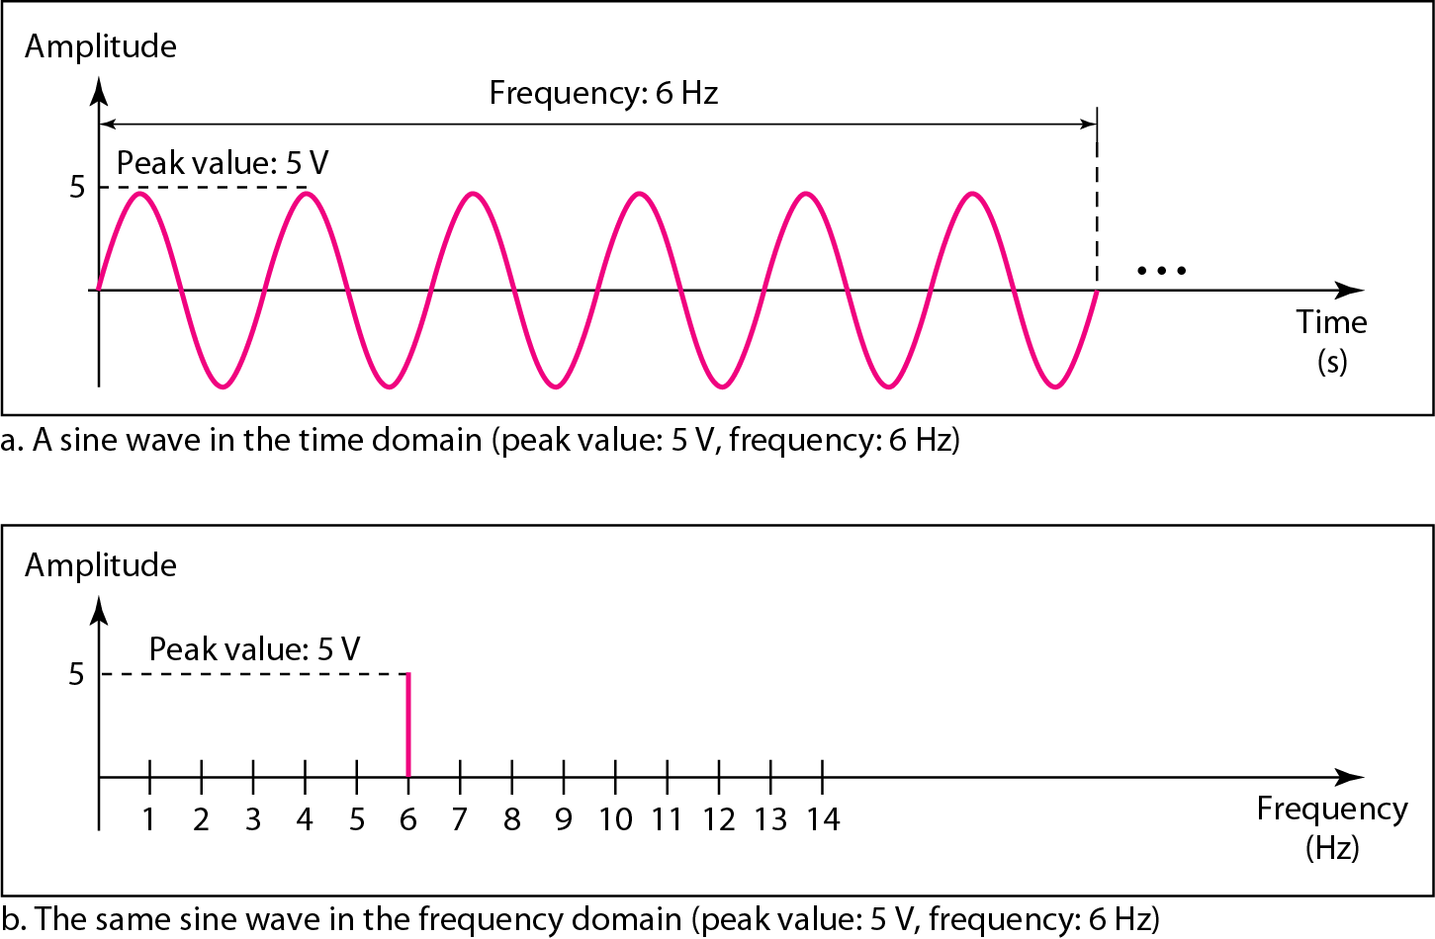
Figure 3.7 The time-domain and frequency-domain plots of a sine wave

Slide 41
Note
A complete sine wave in the time domain can be represented by one single spike in the frequency domain.

Slide 42
Example 3.7
The frequency domain is more compact and useful when we are dealing with more than one sine wave. For example, Figure 3.8 shows three sine waves, each with different amplitude and frequency. All can be represented by three spikes in the frequency domain.

Slide 43
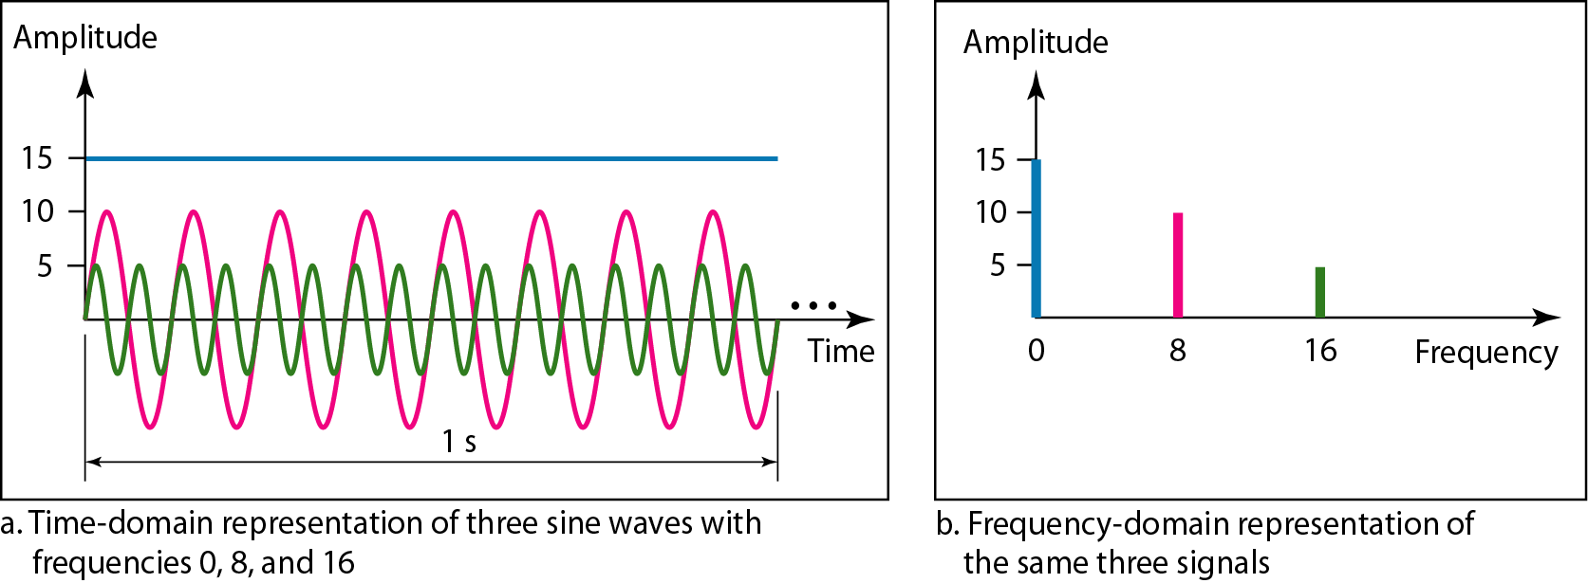
Figure 3.8 The time domain and frequency domain of three sine waves

Slide 44
Note
A single-frequency sine wave is not useful in data communications;
we need to send a composite signal, a signal made of many simple sine waves.

Slide 45
Note
According to Fourier analysis, any composite signal is a combination of
simple sine waves with different frequencies, amplitudes, and phases.
Fourier analysis is discussed in Appendix C.

Slide 46
Note
If the composite signal is periodic, the decomposition gives a series of signals with discrete frequencies; if the composite signal is nonperiodic, the decomposition gives a combination of sine waves with continuous frequencies.

Slide 47
Example 3.8
Figure 3.9 shows a periodic composite signal with frequency f. This type of signal is not typical of those found in data communications. We can consider it to be three alarm systems, each with a different frequency. The analysis of this signal can give us a good understanding of how to decompose signals.

Slide 48
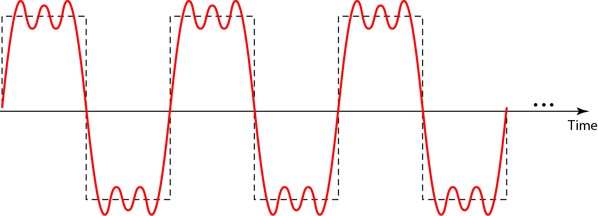
Figure 3.9 A composite periodic signal

Slide 49
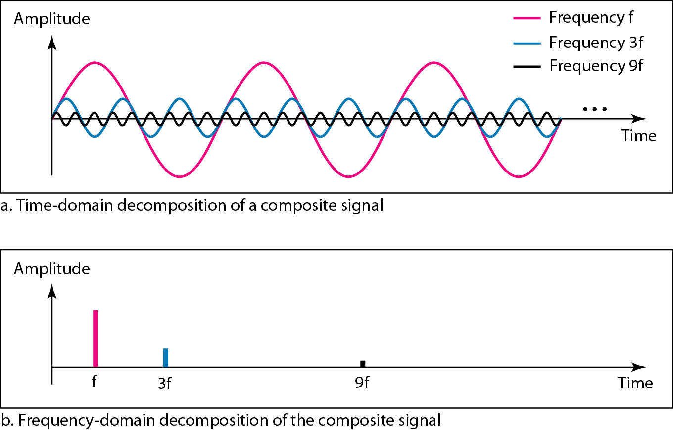
Figure 3.10 Decomposition of a composite periodic signal in the time and frequency domains

Slide 50
Example 3.9
Figure 3.11 shows a nonperiodic composite signal. It can be the signal created by a microphone or a telephone set when a word or two is pronounced. In this case, the composite signal cannot be periodic, because that implies that we are repeating the same word or words with exactly the same tone.

Slide 51
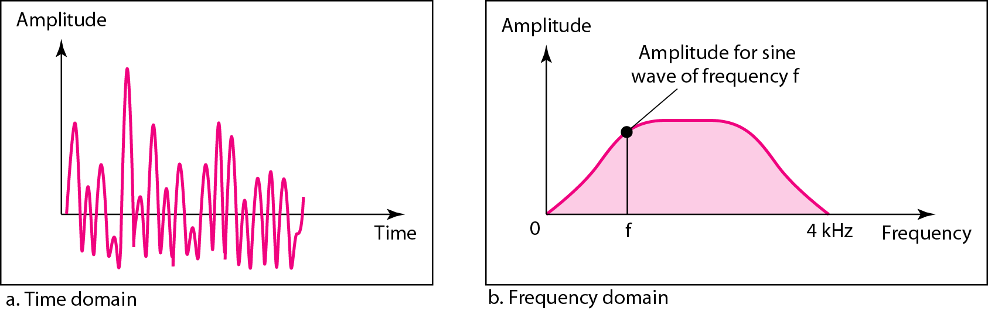
Figure 3.11 The time and frequency domains of a nonperiodic signal

Slide 52
Note
The bandwidth of a composite signal is the difference between the
highest and the lowest frequencies contained in that signal.

Slide 53
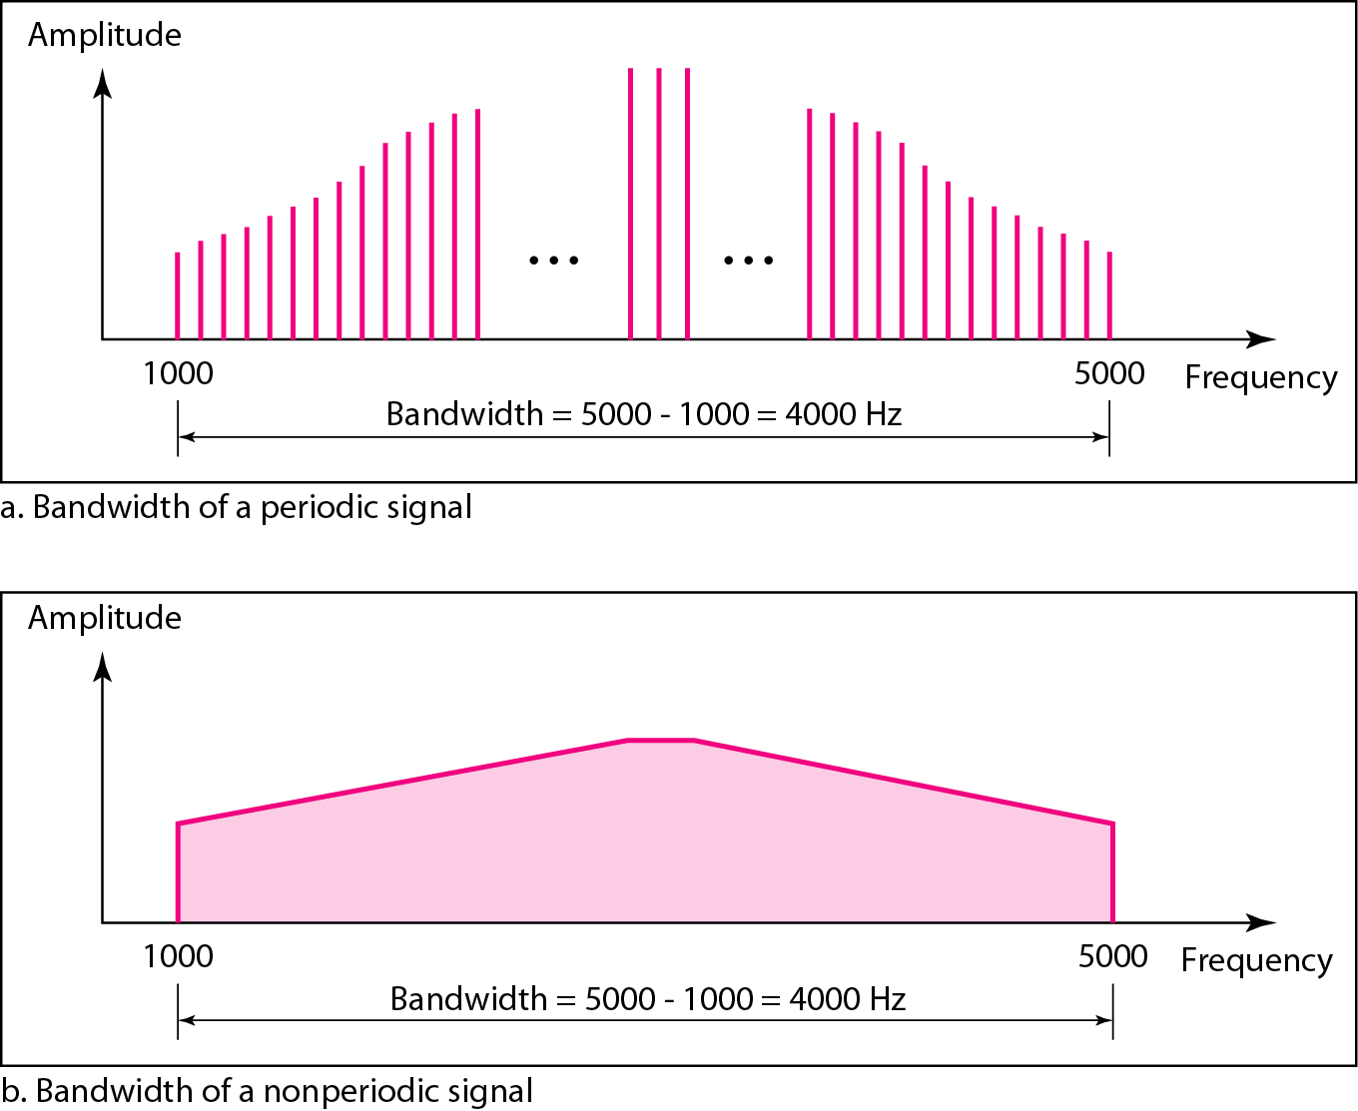
Figure 3.12 The bandwidth of periodic and nonperiodic composite signals

Slide 54
Example 3.10
If a periodic signal is decomposed into five sine waves with frequencies of 100, 300, 500, 700, and 900 Hz, what is its bandwidth? Draw the spectrum, assuming all components have a maximum amplitude of 10 V.
Solution
Let f_{h} be the highest frequency, f_{l} the lowest frequency, and B the bandwidth. Then
The spectrum has only five spikes, at 100, 300, 500, 700, and 900 Hz (see Figure 3.13).

Slide 55
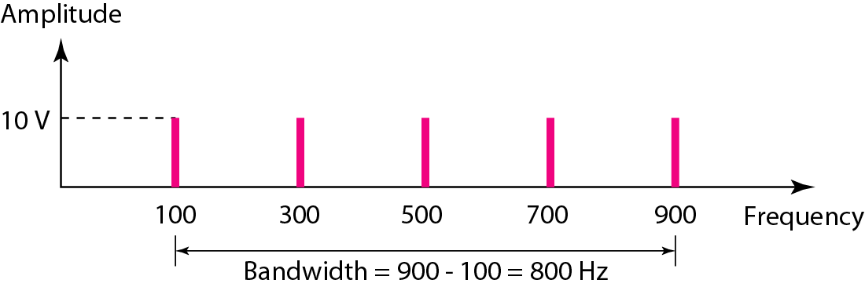
Figure 3.13 The bandwidth for Example 3.10

Slide 56
Example 3.11
A periodic signal has a bandwidth of 20 Hz. The highest frequency is 60 Hz. What is the lowest frequency? Draw the spectrum if the signal contains all frequencies of the same amplitude.
Solution
Let f_{h} be the highest frequency, f_{l} the lowest frequency, and B the bandwidth. Then
The spectrum contains all integer frequencies. We show this by a series of spikes (see Figure 3.14).

Slide 57
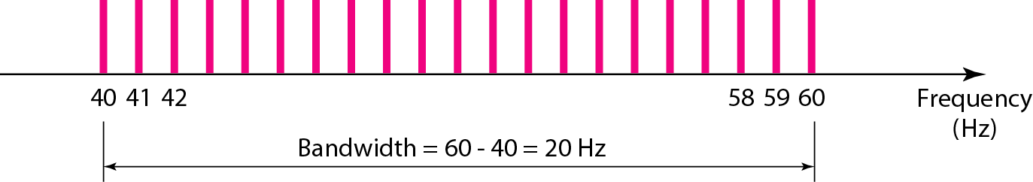
Figure 3.14 The bandwidth for Example 3.11

Slide 58
Example 3.12
A nonperiodic composite signal has a bandwidth of 200 kHz, with a middle frequency of 140 kHz and peak amplitude of 20 V. The two extreme frequencies have an amplitude of 0. Draw the frequency domain of the signal.
Solution
The lowest frequency must be at 40 kHz and the highest at 240 kHz. Figure 3.15 shows the frequency domain and the bandwidth.

Slide 59
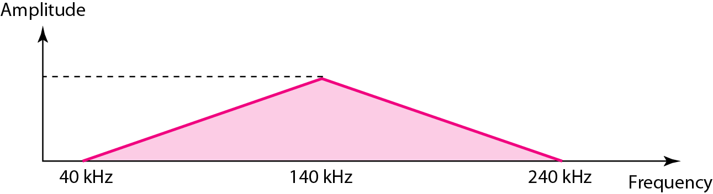
Figure 3.15 The bandwidth for Example 3.12

Slide 60
Example 3.13
An example of a nonperiodic composite signal is the signal propagated by an AM radio station. In the United States, each AM radio station is assigned a 10-kHz bandwidth. The total bandwidth dedicated to AM radio ranges from 530 to 1700 kHz. We will show the rationale behind this 10-kHz bandwidth in Chapter 5.

Slide 61
Example 3.14
Another example of a nonperiodic composite signal is the signal propagated by an FM radio station. In the United States, each FM radio station is assigned a 200-kHz bandwidth. The total bandwidth dedicated to FM radio ranges from 88 to 108 MHz. We will show the rationale behind this 200-kHz bandwidth in Chapter 5.

Slide 62
Example 3.15
Another example of a nonperiodic composite signal is the signal received by an old-fashioned analog black-and-white TV. A TV screen is made up of pixels. If we assume a resolution of 525 × 700, we have 367,500 pixels per screen. If we scan the screen 30 times per second, this is 367,500 × 30 = 11,025,000 pixels per second. The worst-case scenario is alternating black and white pixels. We can send 2 pixels per cycle. Therefore, we need 11,025,000 / 2 = 5,512,500 cycles per second, or Hz. The bandwidth needed is 5.5125 MHz.

Slide 63
DIGITAL SIGNALS
In addition to being represented by an analog signal, information can also be represented by a digital signal. For example, a 1 can be encoded as a positive voltage and a 0 as zero voltage. A digital signal can have more than two levels. In this case, we can send more than 1 bit for each level.
Topics discussed in this section:
Bit Rate Bit Length Digital Signal as a Composite Analog Signal
Application Layer

Slide 64
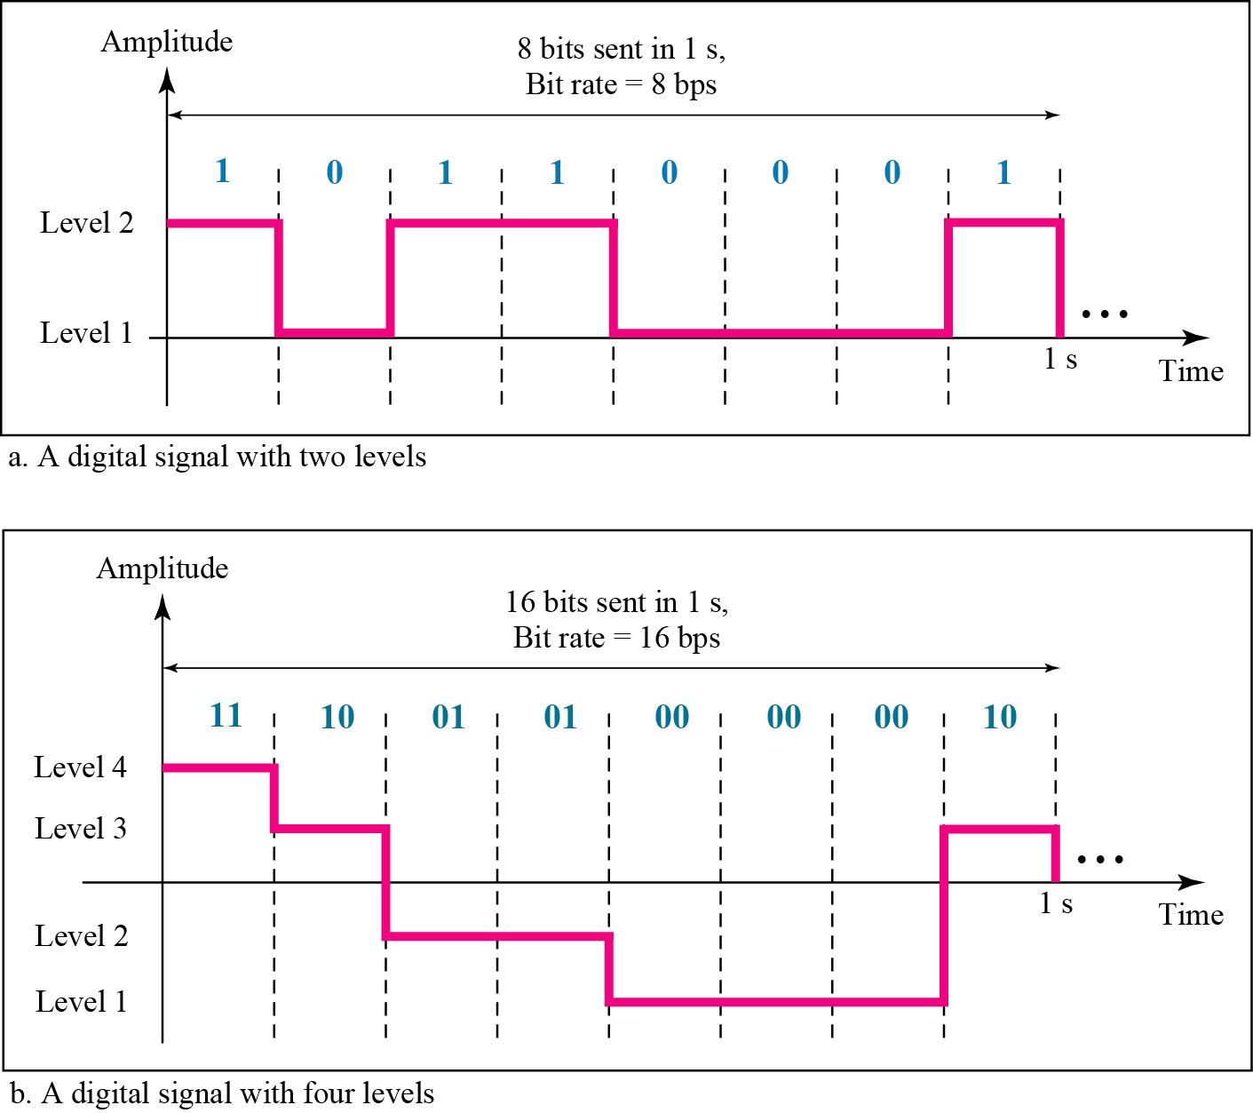
Figure 3.16 Two digital signals: one with two signal levels and the other with four signal levels

Slide 65
Note
Appendix C reviews information about exponential and logarithmic functions.
Appendix C reviews information about exponential and logarithmic functions.

Slide 66
Example 3.16
A digital signal has eight levels. How many bits are needed per level? We calculate the number of bits from the formula
Each signal level is represented by 3 bits.

Slide 67
Example 3.17
A digital signal has nine levels. How many bits are needed per level? We calculate the number of bits by using the formula. Each signal level is represented by 3.17 bits. However, this answer is not realistic. The number of bits sent per level needs to be an integer as well as a power of 2. For this example, 4 bits can represent one level.

Slide 68
Example 3.18
Assume we need to download text documents at the rate of 100 pages per minute. What is the required bit rate of the channel?
Solution
A page is an average of 24 lines with 80 characters in each line. If we assume that one character requires 8 bits, the bit rate is

Slide 69
Example 3.19
A digitized voice channel, as we will see in Chapter 4, is made by digitizing a 4-kHz bandwidth analog voice signal. We need to sample the signal at twice the highest frequency (two samples per hertz). We assume that each sample requires 8 bits. What is the required bit rate?
Solution
The bit rate can be calculated as

Slide 70
Example 3.20
What is the bit rate for high-definition TV (HDTV)?
Solution
HDTV uses digital signals to broadcast high quality video signals. The HDTV screen is normally a ratio of 16 : 9. There are 1920 by 1080 pixels per screen, and the screen is renewed 30 times per second. Twenty-four bits represents one color pixel.
The TV stations reduce this rate to 20 to 40 Mbps through compression.

Slide 71
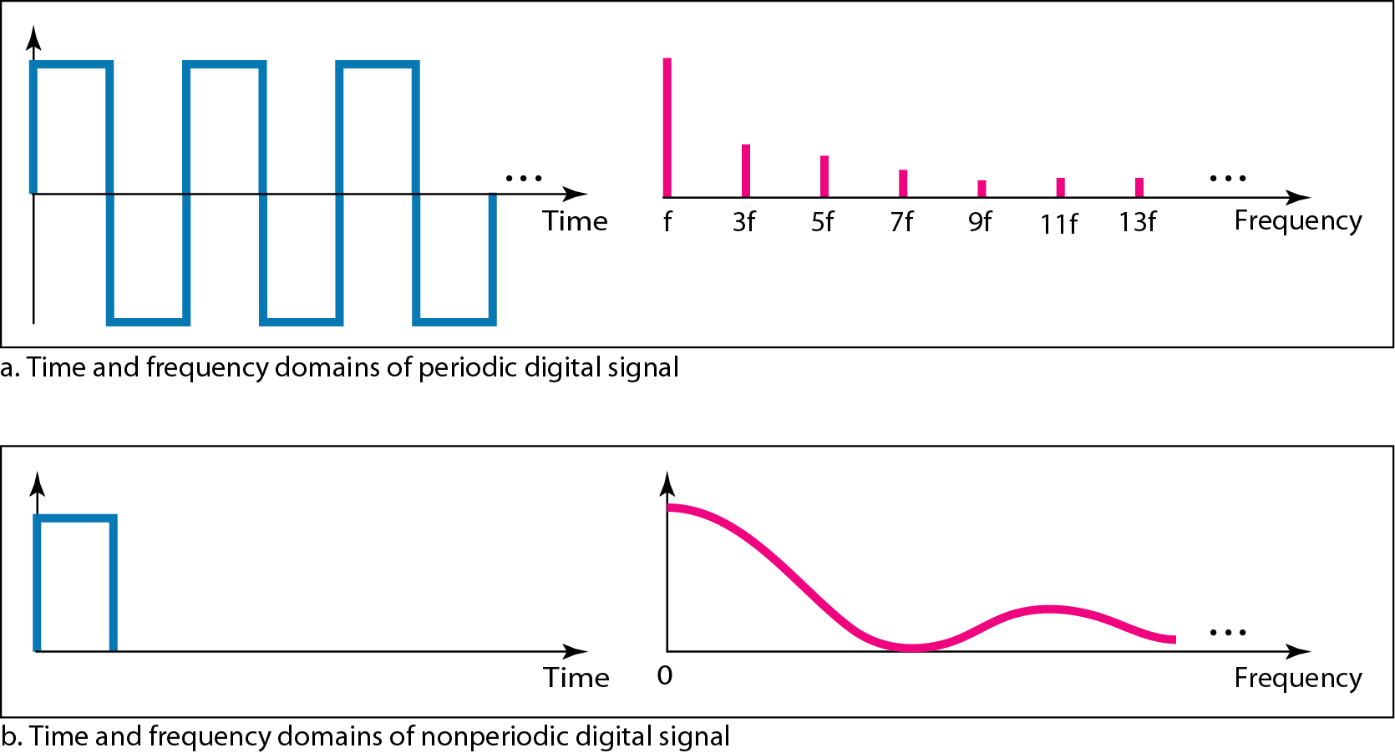
Figure 3.17 The time and frequency domains of periodic and nonperiodic digital signals

Slide 72
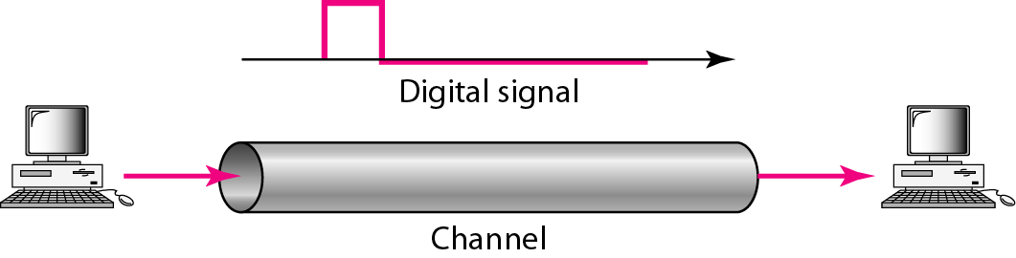
Figure 3.18 Baseband transmission

Slide 73
Note
A digital signal is a composite analog signal with an infinite bandwidth.

Slide 74
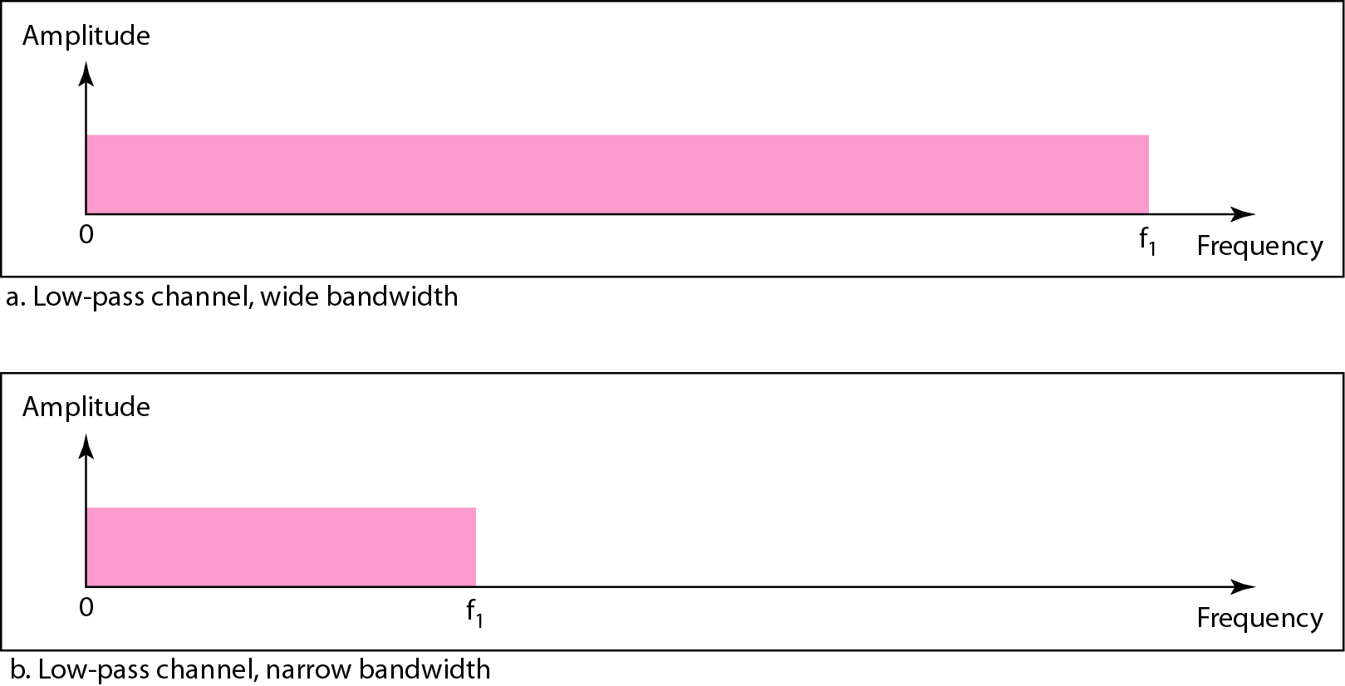
Figure 3.19 Bandwidths of two low-pass channels

Slide 75
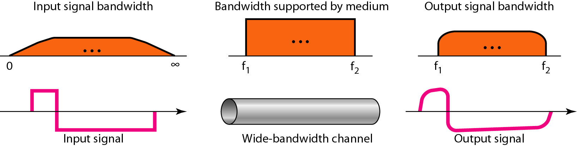
Figure 3.20 Baseband transmission using a dedicated medium

Slide 76
Note
Baseband transmission of a digital signal that preserves the shape of the digital signal is possible only if we have a low-pass channel with an infinite or very wide bandwidth.

Slide 77
Example 3.21
An example of a dedicated channel where the entire bandwidth of the medium is used as one single channel is a LAN. Almost every wired LAN today uses a dedicated channel for two stations communicating with each other. In a bus topology LAN with multipoint connections, only two stations can communicate with each other at each moment in time (timesharing); the other stations need to refrain from sending data. In a star topology LAN, the entire channel between each station and the hub is used for communication between these two entities. We study LANs in Chapter 14.

Slide 78
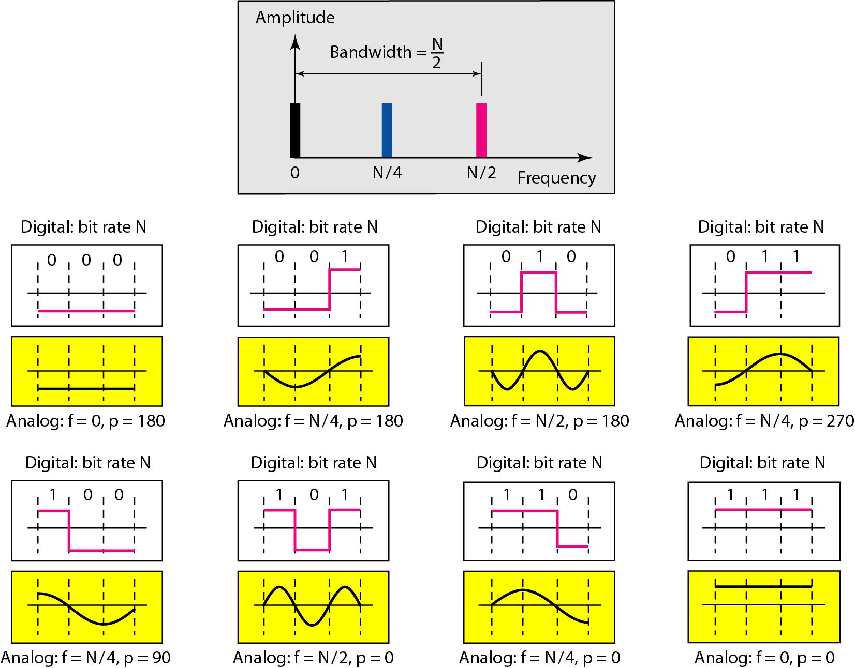
Figure 3.21 Rough approximation of a digital signal using the first harmonic for worst case

Slide 79
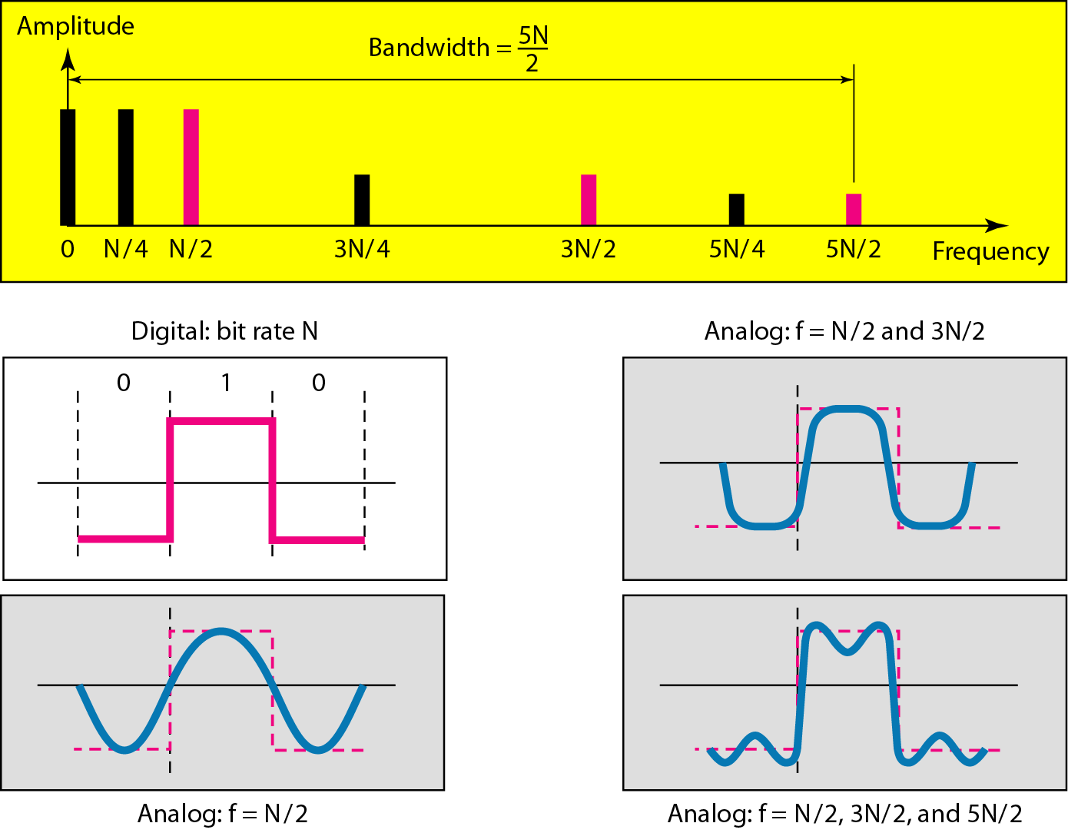
Figure 3.22 Simulating a digital signal with first three harmonics

Slide 80
Note
In baseband transmission, the required bandwidth is proportional to the bit rate;
if we need to send bits faster, we need more bandwidth.
In baseband transmission, the required bandwidth is proportional to the bit rate;
if we need to send bits faster, we need more bandwidth.

Slide 81
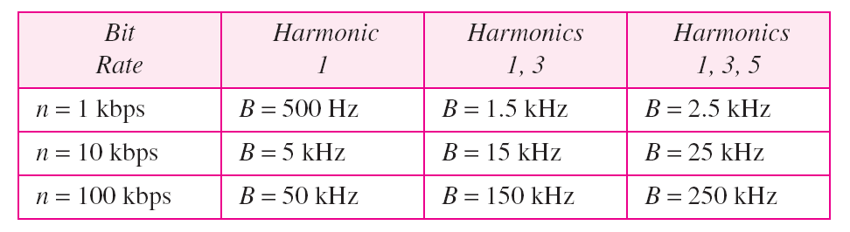
Table 3.2 Bandwidth requirements

Slide 82
Example 3.22
What is the required bandwidth of a low-pass channel if we need to send 1 Mbps by using baseband transmission?
Solution
The answer depends on the accuracy desired.
a. The minimum bandwidth, is B = bit rate /2, or 500 kHz.
b. A better solution is to use the first and the third harmonics with B = 3 × 500 kHz = 1.5 MHz.
c. Still a better solution is to use the first, third, and fifth harmonics with B = 5 × 500 kHz = 2.5 MHz.

Slide 83
Example 3.22
We have a low-pass channel with bandwidth 100 kHz. What is the maximum bit rate of this
channel?
Solution
The maximum bit rate can be achieved if we use the first harmonic. The bit rate is 2 times the available bandwidth, or 200 kbps.

Slide 84
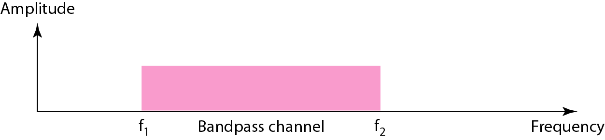
Figure 3.23 Bandwidth of a bandpass channel

Slide 85
Note
If the available channel is a bandpass channel, we cannot send the digital signal directly to the channel; we need to convert the digital signal to an analog signal before transmission.

Slide 86
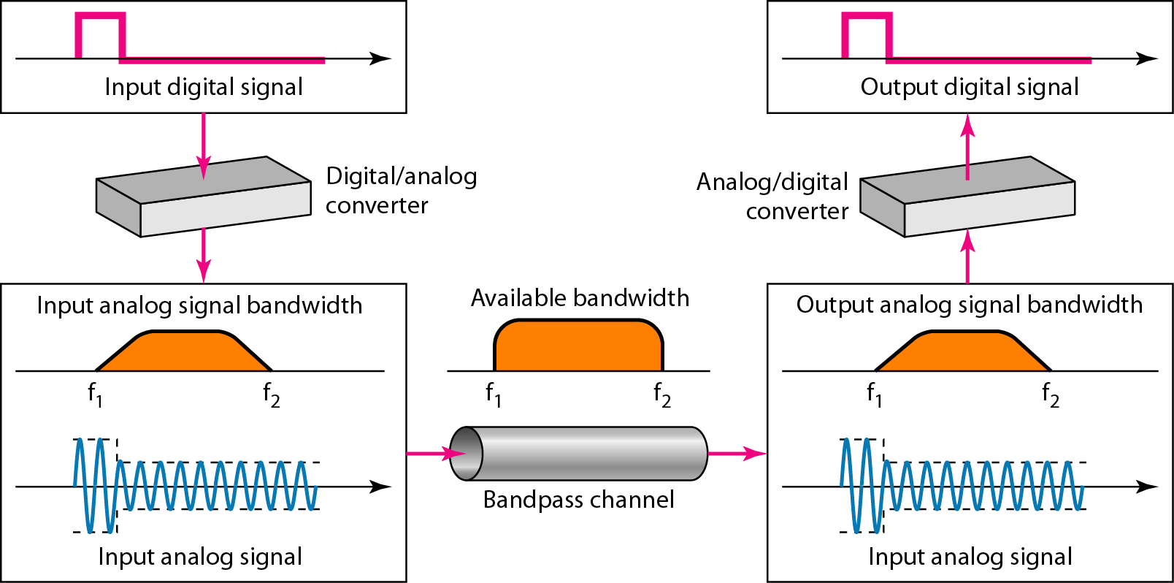
Figure 3.24 Modulation of a digital signal for transmission on a bandpass channel

Slide 87
Example 3.24
An example of broadband transmission using modulation is the sending of computer data through a telephone subscriber line, the line connecting a resident to the central telephone office. These lines are designed to carry voice with a limited bandwidth. The channel is considered a bandpass channel. We convert the digital signal from the computer to an analog signal, and send the analog signal. We can install two converters to change the digital signal to analog and vice versa at the receiving end. The converter, in this case, is called a modem which we discuss in detail in Chapter 5.

Slide 88
Example 3.25
A second example is the digital cellular telephone. For better reception, digital cellular phones convert the analog voice signal to a digital signal (see Chapter 16). Although the bandwidth allocated to a company providing digital cellular phone service is very wide, we still cannot send the digital signal without conversion. The reason is that we only have a bandpass channel available between caller and callee. We need to convert the digitized voice to a composite analog signal before sending.

Slide 89
3-4 TRANSMISSION IMPAIRMENT
Signals travel through transmission media, which are not perfect. The imperfection causes signal impairment. This means that the signal at the beginning of the medium is not the same as the signal at the end of the medium. What is sent is not what is received. Three causes of impairment are attenuation, distortion, and noise.
Topics discussed in this section:
Attenuation Distortion Noise

Slide 90
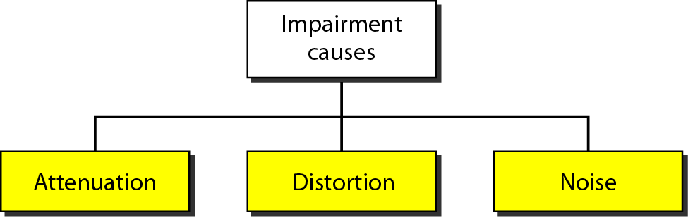
Figure 3.25 Causes of impairment

Slide 91
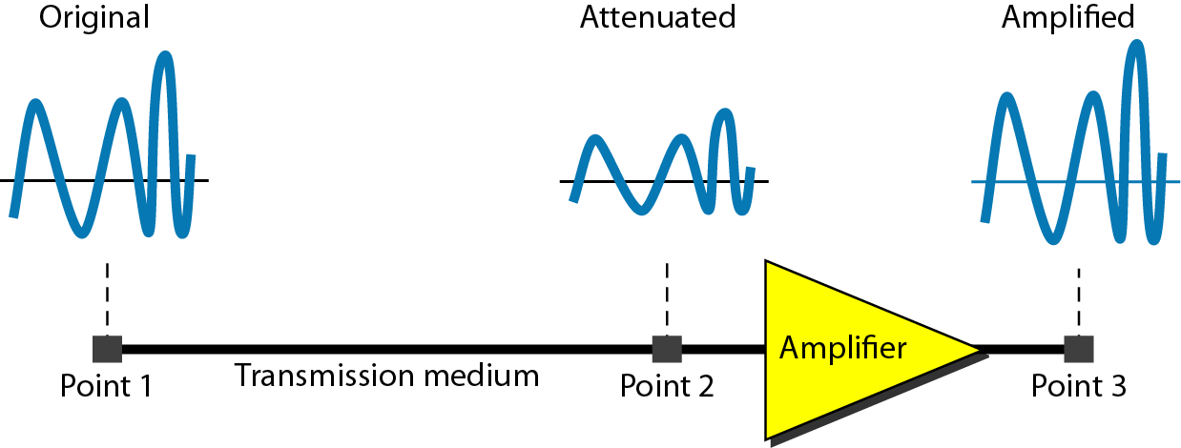
Figure 3.26 Attenuation

Slide 92

Example 3.26
Suppose a signal travels through a transmission medium and its power is reduced to one-half. This means that P2 is (1/2)P1. In this case, the attenuation (loss of power) can be calculated as
A loss of 3 dB (–3 dB) is equivalent to losing one-half the power.

Slide 93

Example 3.27
A signal travels through an amplifier, and its power is increased 10 times. This means that P₂ = 10P₁ . In this case, the amplification (gain of power) can be calculated as

Slide 94

Example 3.28
One reason that engineers use the decibel to measure the changes in the strength of a signal is that decibel numbers can be added (or subtracted) when we are measuring several points (cascading) instead of just two. In Figure 3.27 a signal travels from point 1 to point 4. In this case, the decibel value can be calculated as

Slide 95
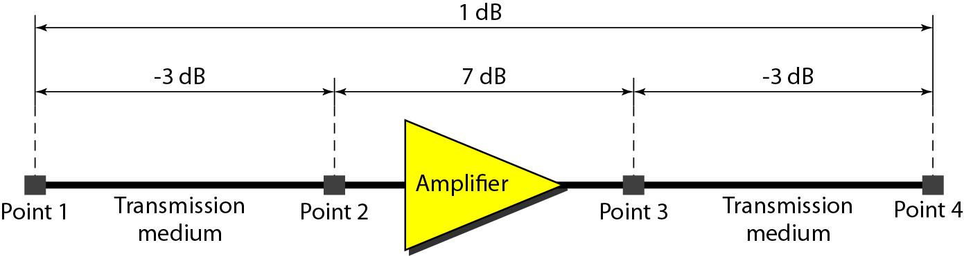
Figure 3.27 Decibels for Example 3.28

Slide 96
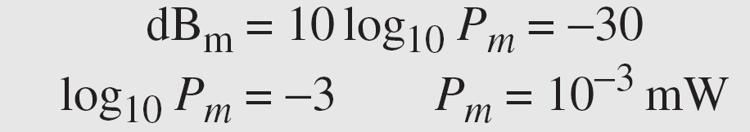
Example 3.29
Sometimes the decibel is used to measure signal power in milliwatts. In this case, it is referred to as dB_{m} and is calculated as dB_{m} = 10 log10 P_{m} , where P_{m} is the power in milliwatts. Calculate the power of a signal with dB_{m} = −30.
Solution
We can calculate the power in the signal as

Slide 97
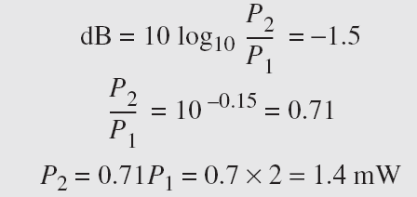
Example 3.30
The loss in a cable is usually defined in decibels per kilometer (dB/km). If the signal at the beginning of a cable with −0.3 dB/km has a power of 2 mW, what is the power of the signal at 5 km?
Solution
The loss in the cable in decibels is 5 × (−0.3) = −1.5 dB. We can calculate the power as

Slide 98
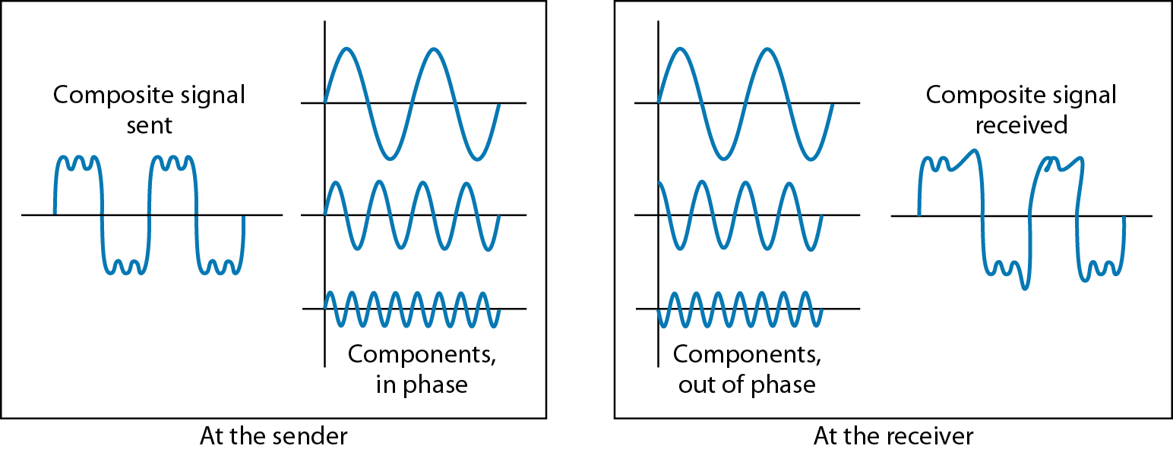
Figure 3.28 Distortion

Slide 99
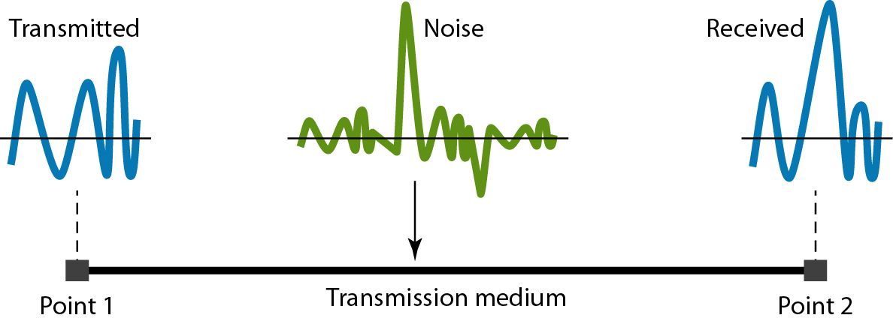
Figure 3.29 Noise

Slide 100
Example 3.31
The power of a signal is 10 mW and the power of the noise is 1 μW; what are the values of SNR and SNR_{dB} ?
Solution
The values of SNR and SNRdB can be calculated as follows:

Slide 101
Example 3.32
The values of SNR and SNRdB for a noiseless channel are
We can never achieve this ratio in real life; it is an ideal.

Slide 102
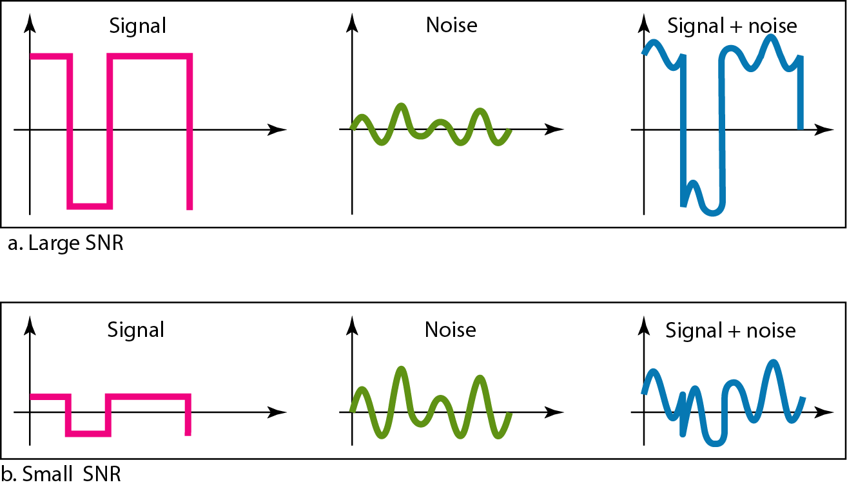
Figure 3.30 Two cases of SNR: a high SNR and a low SNR

Slide 103
3-5 DATA RATE LIMITS
A very important consideration in data communications is how fast we can send data, in bits per second, over a channel. Data rate depends on three factors:
1. The bandwidth available
2. The level of the signals we use
3. The quality of the channel (the level of noise)
Topics discussed in this section:
Noiseless Channel: Nyquist Bit Rate Noisy Channel: Shannon Capacity Using Both Limits

Slide 104
Note
Increasing the levels of a signal may reduce the reliability of the system.

Slide 105
Example 3.33
Does the Nyquist theorem bit rate agree with the intuitive bit rate described in baseband transmission?
Solution
They match when we have only two levels. We said, in baseband transmission, the bit rate is 2 times the bandwidth if we use only the first harmonic in the worst case. However, the Nyquist formula is more general than what we derived intuitively; it can be applied to baseband transmission and modulation. Also, it can be applied when we have two or more levels of signals.

Slide 106
Example 3.34
Consider a noiseless channel with a bandwidth of 3000 Hz transmitting a signal with two signal levels. The maximum bit rate can be calculated as

Slide 107
Example 3.35
Consider the same noiseless channel transmitting a signal with four signal levels (for each level, we send 2 bits). The maximum bit rate can be calculated as

Slide 108
Example 3.36
We need to send 265 kbps over a noiseless channel with a bandwidth of 20 kHz. How many signal levels do we need?
Solution
We can use the Nyquist formula as shown:
Since this result is not a power of 2, we need to either increase the number of levels or reduce the bit rate. If we have 128 levels, the bit rate is 280 kbps. If we have 64 levels, the bit rate is 240 kbps.

Slide 109
Example 3.37
Consider an extremely noisy channel in which the value of the signal-to-noise ratio is almost zero. In other words, the noise is so strong that the signal is faint. For this channel the capacity C is calculated as
This means that the capacity of this channel is zero regardless of the bandwidth. In other words, we cannot receive any data through this channel.

Slide 110
Example 3.38
We can calculate the theoretical highest bit rate of a regular telephone line. A telephone line normally has a bandwidth of 3000. The signal-to-noise ratio is usually 3162. For this channel the capacity is calculated as
This means that the highest bit rate for a telephone line is 34.860 kbps. If we want to send data faster than this, we can either increase the bandwidth of the line or improve the signal-to-noise ratio.

Slide 111
Example 3.39
The signal-to-noise ratio is often given in decibels. Assume that SNR_{dB} = 36 and the channel bandwidth is 2 MHz. The theoretical channel capacity can be calculated as

Slide 112


Example 3.40
For practical purposes, when the SNR is very high, we can assume that SNR + 1 is almost the same as SNR. In these cases, the theoretical channel capacity can be simplified to
For example, we can calculate the theoretical capacity of the previous example as

Slide 113
Example 3.41
We have a channel with a 1-MHz bandwidth. The SNR for this channel is 63. What are the appropriate bit rate and signal level?
Solution
First, we use the Shannon formula to find the upper limit.

Slide 114
Example 3.41 (continued)
The Shannon formula gives us 6 Mbps, the upper limit. For better performance we choose something lower, 4 Mbps, for example. Then we use the Nyquist formula to find the number of signal levels.

Slide 115
Note
The Shannon capacity gives us the upper limit; the Nyquist formula tells us how many signal levels we need.

Slide 116
3-6 PERFORMANCE
One important issue in networking is the performance of the network—how good is it? We discuss quality of service, an overall measurement of network performance, in greater detail in Chapter 24. In this section, we introduce terms that we need for future chapters.
Topics discussed in this section:
Bandwidth Throughput Latency (Delay)
Bandwidth-Delay Product

Slide 117
Note
In networking, we use the term bandwidth in two contexts.
❏ The first, bandwidth in hertz, refers to the range of frequencies in a composite signal or the range of frequencies that a channel can pass.
❏ The second, bandwidth in bits per second, refers to the speed of bit transmission in a channel or link.

Slide 118
Example 3.42
The bandwidth of a subscriber line is 4 kHz for voice or data. The bandwidth of this line for data transmission
can be up to 56,000 bps using a sophisticated modem to change the digital signal to analog.

Slide 119
Example 3.43
If the telephone company improves the quality of the line and increases the bandwidth to 8 kHz, we can send 112,000 bps by using the same technology as mentioned in Example 3.42.

Slide 120

Example 3.44
A network with bandwidth of 10 Mbps can pass only an average of 12,000 frames per minute with each frame carrying an average of 10,000 bits. What is the throughput of this network?
Solution
We can calculate the throughput as
The throughput is almost one-fifth of the bandwidth in this case.

Slide 121
Example 3.45
What is the propagation time if the distance between the two points is 12,000 km? Assume the propagation speed to be 2.4 × 108 m/s in cable.
Solution
We can calculate the propagation time as
The example shows that a bit can go over the Atlantic Ocean in only 50 ms if there is a direct cable between the source and the destination.

Slide 122
Example 3.46
What are the propagation time and the transmission time for a 2.5-kbyte message (an e-mail) if the bandwidth of the network is 1 Gbps? Assume that the distance between the sender and the receiver is 12,000 km and that light travels at 2.4 × 108 m/s.
Solution
We can calculate the propagation and transmission time as shown on the next slide:

Slide 123
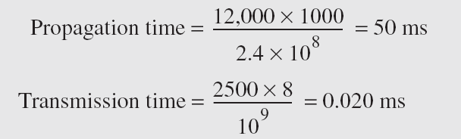
Example 3.46 (continued)
Note that in this case, because the message is short and the bandwidth is high, the dominant factor is the propagation time, not the transmission time. The transmission time can be ignored.

Slide 124
Example 3.47
What are the propagation time and the transmission time for a 5-Mbyte message (an image) if the bandwidth of the network is 1 Mbps? Assume that the distance between the sender and the receiver is 12,000 km and that light travels at 2.4 × 10⁸ m/s.
Solution
We can calculate the propagation and transmission times as shown on the next slide.

Slide 125
Example 3.47 (continued)
Note that in this case, because the message is very long and the bandwidth is not very high, the dominant factor is the transmission time, not the propagation time. The propagation time can be ignored.

Slide 126
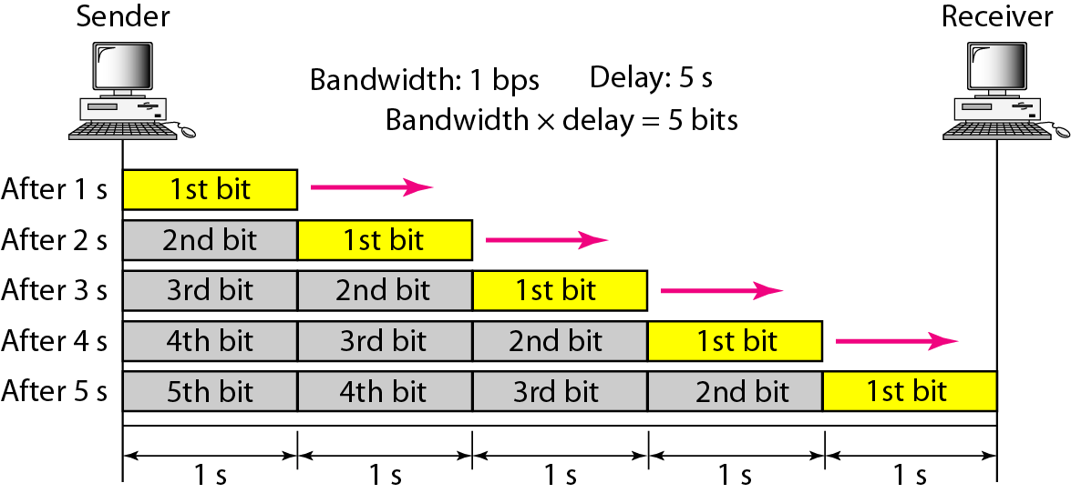
Figure 3.31 Filling the link with bits for case 1

Slide 127
Example 3.48
We can think about the link between two points as a pipe. The cross section of the pipe represents the bandwidth, and the length of the pipe represents the delay. We can say the volume of the pipe defines the bandwidth-delay product, as shown in Figure 3.33.

Slide 128
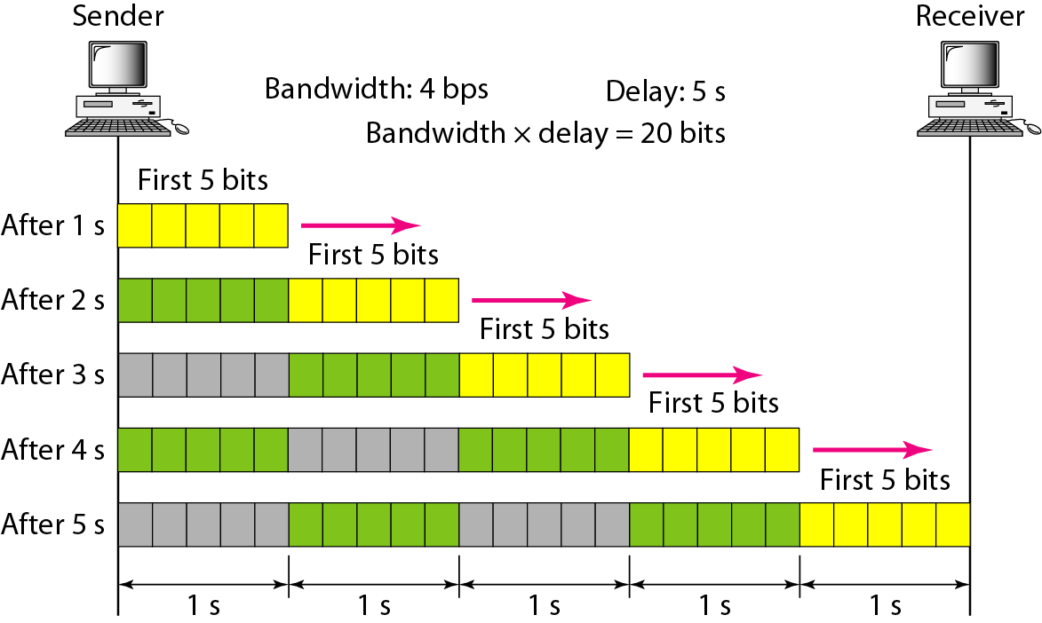
Figure 3.32 Filling the link with bits in case 2

Slide 129
Note
The bandwidth-delay product defines the number of bits that can fill the link.

Slide 130

Figure 3.33 Concept of bandwidth-delay product

